Slide 1
SUNSHINE HEALTH FREEDOM FOUNDATION
State Heath Freedom Campaign
Diane Miller JD
Director Law and Public Policy
National Health Freedom Action
April, 2017
Orlando, FL

Slide 2
Sunshine Health Freedom Foundation’s “VISION”
“We are blazing a trail for generations to come
that will allow our children to have health freedom
based on what they, not the government,
believe are the best choices.”

Slide 3
Law - The Voice of
Freedom…

Slide 4
State Law
PRACTICE OF MEDICINE
Defined
“…(1) Offers or undertakes to diagnose, cure, advise, or prescribe for any human disease, ailment, injury, infirmity, deformity, pain or other condition, physical or mental, real or imaginary, by any means or instrumentality;…” Washington RCW 18.71.011
Notes:
Broad definitions
Good for the profession because gives them great latitude in treating
Describes many tools that they have

Slide 5
Kansas Healing Arts
Not a Natural Right
65-2801
Chapter 65.--PUBLIC HEALTH
Article 28.--HEALING ARTS
65-2801. Purpose. Recognizing that the practice of the healing arts is a privilege granted by legislative authority and is not a natural right of individuals, it is deemed necessary as a matter of policy in the interests of public health, safety and welfare, to provide laws and provisions covering the granting of that privilege and its subsequent use, control and regulation to the end that the public shall be properly protected against unprofessional, improper, unauthorized and unqualified practice of the healing arts and from unprofessional conduct by persons licensed to practice under this act.
History: L. 1957, ch. 343, § 1; July 1.
Notes:
Broad definitions
Good for the profession because gives them great latitude in treating
Describes many tools that they have

Slide 6
Maryland State Law
Practice of Naturopathic Medicine
§14–5F–01.
(g) (1) “Naturopathic medicine” means the prevention, diagnosis, and treatment of human health conditions, injury, and disease using only patient education and naturopathic therapies and therapeutic substances recognized by the Council of Naturopathic Medical Education.
(2) “Naturopathic medicine” includes:
(i) Counseling;
(ii) The practice of the mechanical sciences of healing, including mechanotherapy, articular manipulation, corrective and orthopedic gymnastics, hydrotherapy, electrotherapy, and phototherapy; and
(iii) The practice of the material sciences of healing, including nutrition, phytotherapy, treatment by natural substances, and external applications.

Slide 7
Maryland State Law
Practice of Naturopathic Medicine
§14–5F–29.
(a) Except as otherwise provided in this subtitle, an individual may not practice, attempt to practice, or offer to practice naturopathic medicine in this State without a license.
(b) An individual who violates this section is guilty of a felony and on conviction is subject to:
(1) A fine not exceeding $10,000 or imprisonment not exceeding 5 years or both; and
(2) A civil fine of no more than $50,000 to be levied by the Board.

Slide 8
Maryland State Law
Practice of Naturopathic Medicine
§14–5F–30.
(a) Unless an individual is licensed to practice naturopathic medicine, the individual may not:
(1) Represent to the public by title, by description of services, methods, or procedures, or otherwise, that the individual is licensed by the Board to practice naturopathic medicine;
(2) Use the title “doctor of naturopathic medicine”, “doctor of naturopathy”, “naturopathic doctor”, or “naturopath”; or
(3) Use the initials “N.D.”, “ND”, “NMD”, or “N.M.D.” after the name of the individual.
(b) An individual licensed to practice naturopathic medicine in the State may not use the title “physician”.

Slide 9
New Mexico 61-35-2 Complementary and Alternative Health Care Services:
B. "complementary and alternative health care service" means the broad domain of complementary and alternative healing methods and treatments including: (1) anthroposophy; (2) aromatherapy; (3) ayurveda; (4) culturally traditional healing practices, including practices by a curandera, sobadora, partera, medica and arbolaira, and healing traditions, including plant medicines and foods, prayer, ceremony and song; (5) detoxification practices and therapies; (6) energetic healing; (7) folk practices; (8) Gerson therapy and colostrum therapy; (9) healing practices utilizing food, dietary supplements, nutrients and the physical forces of heat, cold, water, touch and light; (10) healing touch; (11) herbology or herbalism; (12) homeopathy; (13) meditation; (14) mind-body healing practices; (15) naturopathy; (16) nondiagnostic iridology; (17) noninvasive instrumentalities; (18) polarity therapy; and (19) holistic kinesiology and other muscle testing techniques

Slide 10
Sunshine Health Freedom Foundation’s “STRATEGY”
FOCUS
passing one state at a time!

Slide 11
2017 Safe Harbor
Health Freedom States!
Oklahoma *
Idaho *
Minnesota
Rhode Island
California
Louisiana
Arizona (limited)
New Mexico
Colorado
Nevada!

Slide 12
ME
WA
MT
ND
MN
MI
NH
NY
VT
WI
MA
SD
OR
ID
WY
OH
CT
RI
NE
IA
PA
IL
IN
NJ
DE
MO
WV
MD
CA
NV
DC
UT
CO
KS
AR
KY
VA
AZ
Homeopathy only
NM
OK
TN
NC
LA
MS
AL
GA
SC
TX
FL
AK
HI

Slide 13
ME
WA
MT
ND
MN
MI
NH
NY
VT
WI
MA
SD
OR
ID
WY
OH
CT
RI
NE
IA
PA
IL
IN
NJ
DE
MO
WV
MD
CA
NV
DC
UT
CO
KS
AR
KY
VA
AZ
homeopathy
NM
OK
TN
NC
LA
MS
AL
GA
SC
TX
FL
AK
HI

Slide 14

HOT SPOT STATES 2017
MN
WI
MA
WA
NV
IA
CA
OK

Slide 15
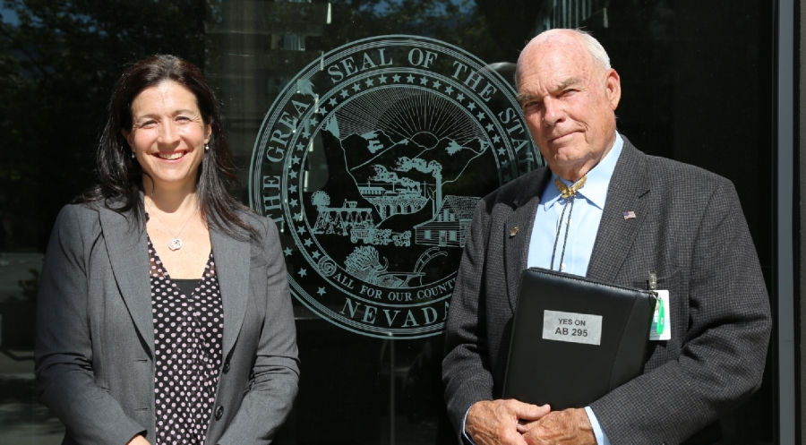

Slide 16
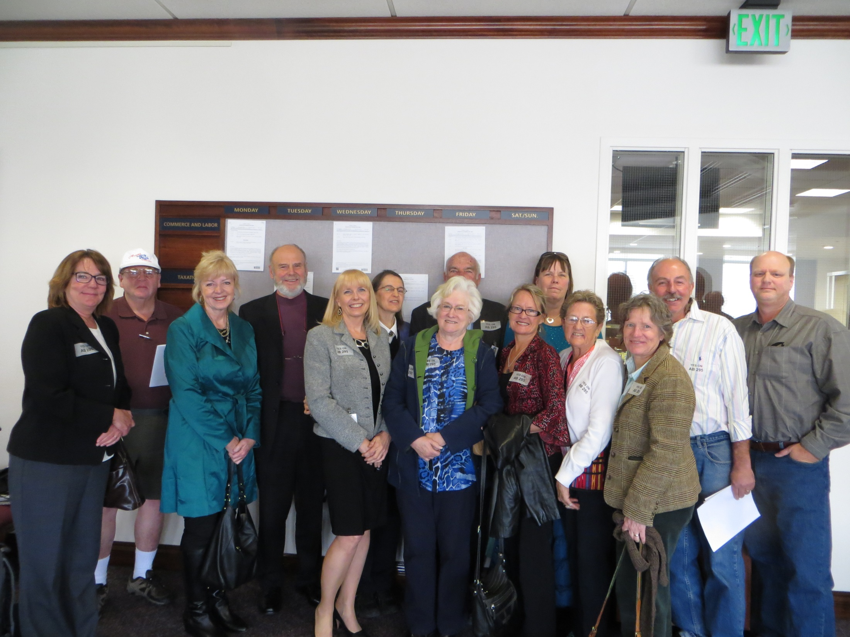

Slide 17
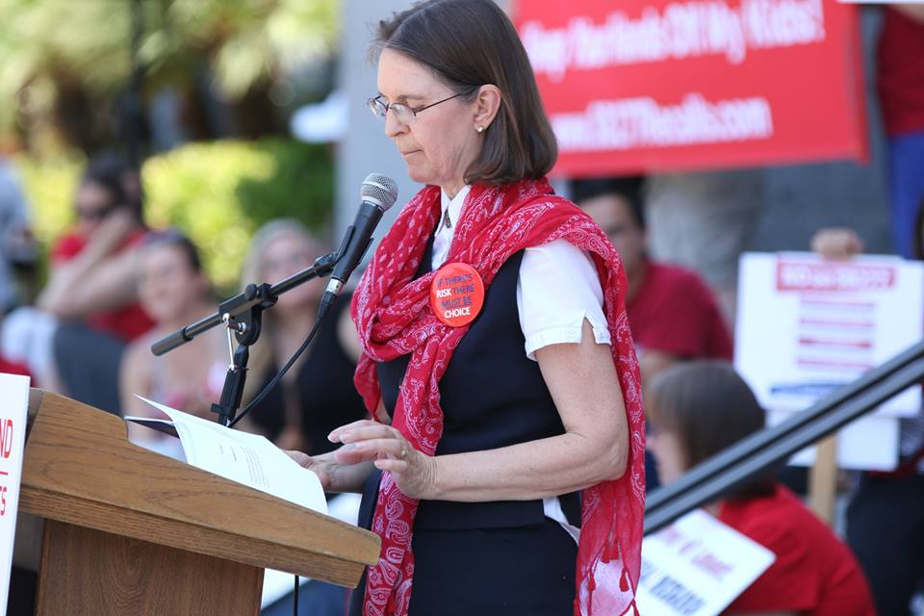
VACCINE MANDATES

Slide 18
GMO Labeling
On Friday, July 29, 2016, President Obama signed the DARK ACT, the bill that denies Americans our Right to Know about GMOs.

Slide 19
Sunshine Health Freedom Foundation
WE NEED YOU ON THE TEAM
* SHFF State Coordinators
* SHFF State Volunteers
* Lobbyists and Consultants on the Ground in States
* SHFF Donors
National Health Freedom Action staff helping:
  Diane Miller JD, and Anne Tenner JD

Slide 20
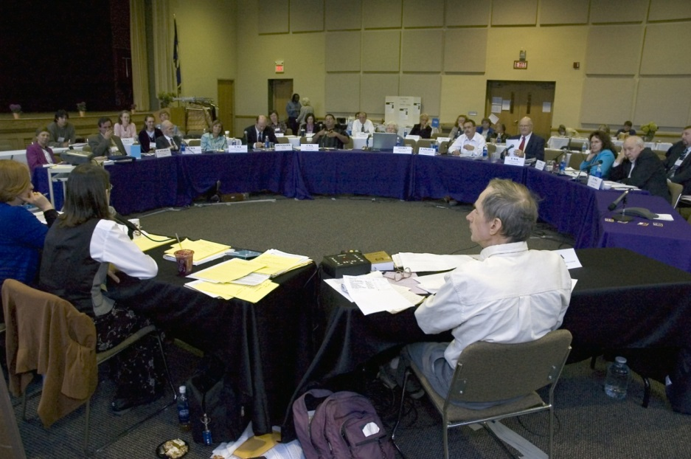
U.S.
Health Freedom Congress
SHFF Member
Reconvened August 1st and 2nd, 2016
St. Olaf College, Northfield, MN

Slide 21
Sunshine
Health Freedom Foundation
Action Steps
Sign Up with SHFF to volunteer in your state
Donate to the SHFF - NSP Fund
We can do this all together!

